Slide 1




Fifa world Cup
Prepare by :
Moses Oloke
Samyak Anand
09.05.2025

Slide 2

The FIFA World Cup is the world’s most prestigious international football.
The competition features the senior men’s national teams from FIFA’s member countries
The tournament is a month-long event held in a host country, with matches played in various cities and stadiums
Page 02

Slide 3

Data Source
The data for this project comes from Kaggle, a popular platform for sharing datasets and data science projects.
The specific FIFA World Cup datasets on Kaggle include detailed information about every match played from 1930 to 2014.
Data covers:
Year, date, stage, stadium, and city for each match
Home and away teams, goals scored, and win conditions
Attendance figures, referees, and assistants
Team line-ups, player information, and match events
These datasets are widely used for football analytics and are compiled from official FIFA records and historical archives2356.
Using Kaggle ensures the data is accessible, reliable, and easy to analyze for trends in World Cup history.
Page 03

Slide 4
Data Cleaning
Removed rows with missing or invalid data (e.g., empty rows at the end of the file).
Fixed formatting issues, such as attendance numbers with periods instead of digits (e.g., "590.549" → "590549").
Converted columns like "Year" and "Attendance" to integers for analysis.
Standardized country and team names for consistency.
Dropped unnecessary columns to keep only relevant information.
Result: Clean, reliable dataset ready for analysis.
Page 04

Slide 5
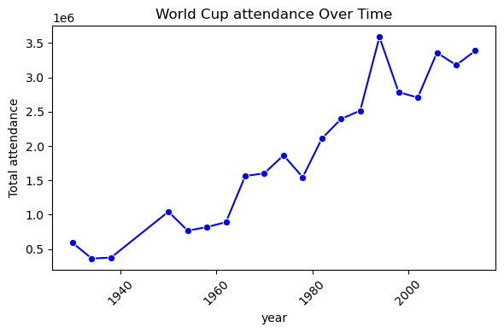
Hypothesis 1
Hypothesis:
The number of spectators at FIFA World Cup tournaments has increased over time.
Analysis:
Early years: 1930 attendance was about 590,549.
Steady growth: 1950 surpassed 1 million; 1994 (USA) set a record with over 3.5 million.
Recent tournaments (2014): Attendance remained high at 3.38 million.
Data shows a clear upward trend, with total and average attendance rising as the tournament expanded and global interest grew.
Conclusion:
The data strongly supports the hypothesis-World Cup attendance has significantly increased over time, making it the world’s most attended sporting event
Page 05

Slide 6
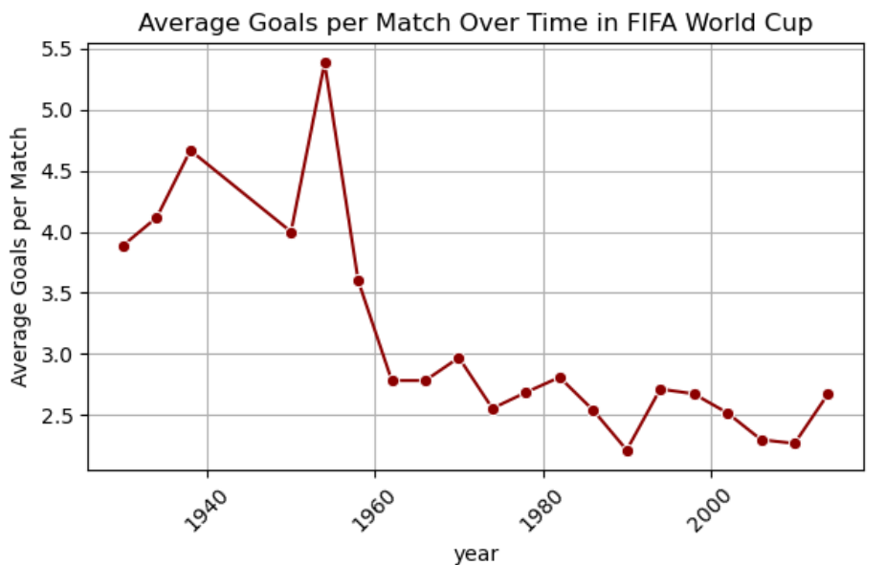
Hypothesis 2
Hypothesis: The average number of goals scored per match in the FIFA World Cup has increased over time.
Analysis:
The highest goals-per-game average was in 1954 (5.38 goals per match).
Recent tournaments (1998–2022) have averaged between 2.3 and 2.7 goals per match.
The 2022 World Cup had an average of 2.69 goals per game, similar to previous recent tournaments.
Trend:
There is no consistent upward trend; the average goals per match has fluctuated over the decades, with a peak in the 1950s and generally lower averages in recent years.
Conclusion:
The hypothesis is not supported. Goals per match have not steadily increased over time; instead, they show a cyclical pattern with both highs and lows across World Cup history.
Page 06

Slide 7
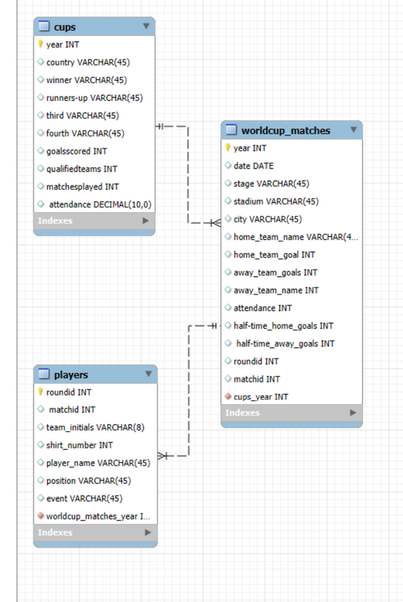
Database Schema
The project uses a relational database to organize FIFA World Cup data for analysis.
Main tables:
cups:
Stores tournament-level info (year, host country, winner, total goals, attendance, etc.).
worldcup_matches:
Contains match details (date, teams, goals, stadium, city, attendance, etc.) linked to each tournament.
players:
Holds player-level data for each match (player name, team, position, events like goals or cards).
Relationships:
Each match links to a specific tournament using a foreign key.
Each player record links to a specific match using a foreign key.
Benefits:
Enables complex analysis across tournaments, matches, and players.
Maintains data integrity and reduces redundancy.
Summary:
This structure supports efficient querying and visualization of World Cup trends at tournament, match, and player level
Page 07

Slide 8
Challenges & Future Scope
Data Cleaning Challenges
Some columns in the dataframe (like attendance and year) were read as floats or strings instead of integers, causing issues for analysis and database import.
Attendance values used periods as thousand separators (e.g., "590.549"), requiring conversion to integer format (e.g., "590549").
Many rows at the end of the file contained only missing values (NaN or <NA>), which had to be removed to keep the dataset accurate.
After cleaning in Python, manual updates were needed in the MySQL database to fix data types and formatting.
How We Fixed It
Used Pandas to convert and clean columns (astype(int), string replace for attendance).
Dropped rows with missing or invalid data.
Manually updated MySQL table columns to correct data types (e.g., changing DECIMAL to INT for attendance).
Future Scope
Integrate MySQL Python Connector for automated data loading and cleaning:
Automate data type checks and conversions during import.
Script updates and cleaning directly from Python, reducing manual database edits.
Enable seamless updates and analytics for future tournaments and new data.
Page 08

Slide 9
Borcelle Club
Github link https://github.com/samyak-anand/Fifa-World-Cup-Project/tree/main
Thank You
Page 13

